Slide 1

Note: The data and information in this document is reflective of a hypothetical situation and client. This document is to be used for KPMG Virtual Internship purposes only.
Sprocket Central Pty Ltd
Data analytics approach
[Division Name] - [Engagement Manager], [Senior Consultant], [Junior Consultant]

Slide 2
Note: The data and information in this document is reflective of a hypothetical situation and client. This document is to be used for KPMG Virtual Internship purposes only.
Agenda
Introduction
Data Exploration
Model Development
Interpretation

Slide 3
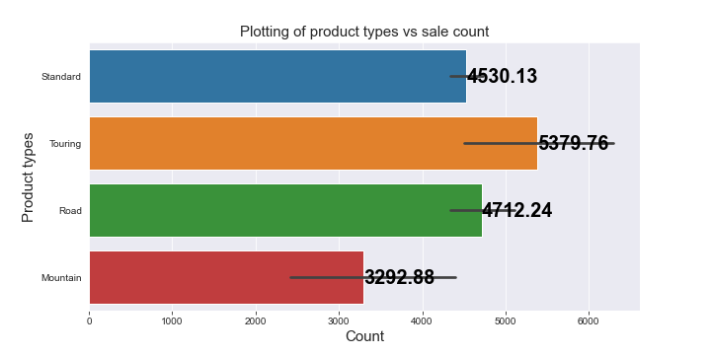
Note: The data and information in this document is reflective of a hypothetical situation and client. This document is to be used for KPMG Virtual Internship purposes only.
Data Exploration
Product types vs their counts
According to the graph plotted, the highest selling product type is the “Touring” range of bikes.
The lowest selling product type is the “Mountain” range of bikes.
Margin is very close between the “Standard” and the “Road” type of bikes.
Place any supporting images, graphs, data or extra text here.

Slide 4
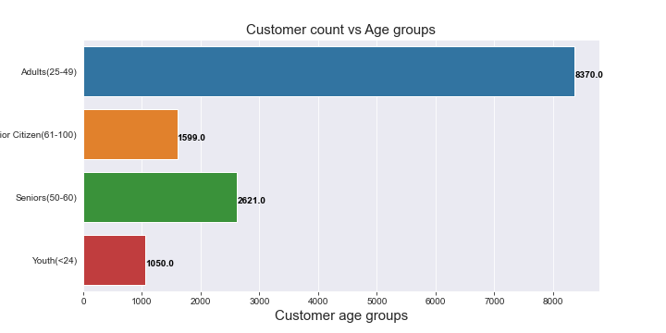
Note: The data and information in this document is reflective of a hypothetical situation and client. This document is to be used for KPMG Virtual Internship purposes only.
Data Exploration
Customers according to age groups
The most popular age group according to the plot made is between the ages of 25 to 49 years.
The least popular age group is till the age of 24 years (the younger segment).
The age group starting from 50 years and above are less likely to have an impact in comparison to the ones between 25 and 49.

Slide 5
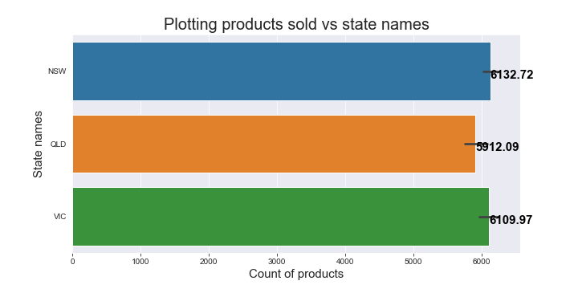
Note: The data and information in this document is reflective of a hypothetical situation and client. This document is to be used for KPMG Virtual Internship purposes only.
Data Exploration
Product sales records by states
The maximum number of sales have been recorded in the state of New South Wales very closely followed by Victoria.
Sales in Queensland is considerably less but allover the margin is very praiseworthy.
It will be profitable in the future to consider New South Wales and Victoria during planning marketing strategies.

Slide 6
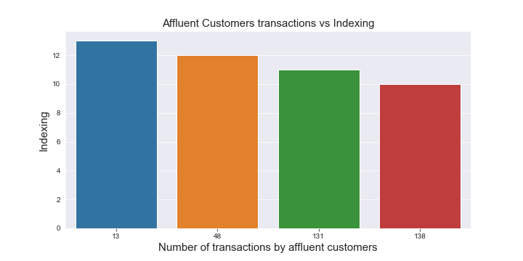
Note: The data and information in this document is reflective of a hypothetical situation and client. This document is to be used for KPMG Virtual Internship purposes only.
Data Exploration
Affluent customers categorical transaction records
Dividing the affluent customer wealth segment category, we get how many transactions have been made over a period of time, depicted in the barplot.
13 times 13 customers have made transactions over items, 12 times 48 customers have made transactions, 131 customers have made a transaction of over 10 times and 138 customers have made transactions exactly 10 times.

Slide 7
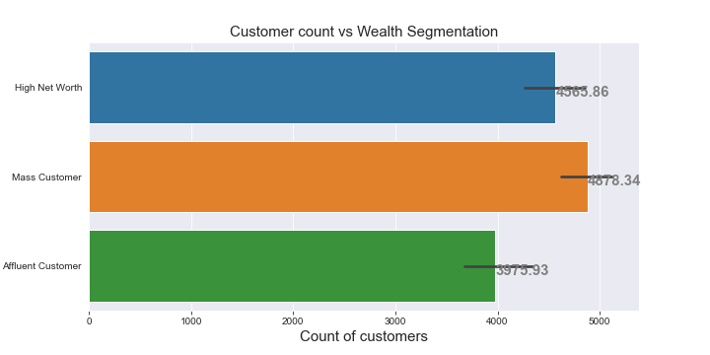
Note: The data and information in this document is reflective of a hypothetical situation and client. This document is to be used for KPMG Virtual Internship purposes only.
Data Exploration
Customer count per wealth segment
Checking the wealth segmentation present in the datasets to find the count of customers per segment, we find that there are a total of 4565 customers with valid details in the “High net worth” range, 4678 customers in the “Mass Customer” range and a number of 3976 customers in the range of “Affluent Customers” range.

Slide 8
Note: The data and information in this document is reflective of a hypothetical situation and client. This document is to be used for KPMG Virtual Internship purposes only.
Interpretation
Preferable insights derived from previous analysis
Affluent Customers can help the business grow exponentially simply due to larger funding capabilities.
The age group of 25-49 years are more likely and favorable to participate in the future growth of the firm.
New South Wales is a top priority followed by Victoria as the sale numbers were high considerably in those states.
The “Touring” range of products are more likely to sell greater in the foreseeable future as previous trends show and the 2nd likely product to hit the market are the “Road” range of bikes.
Excel sheet “Final customers’ list” contains the top 1185 customers who may benefit the organization more likely in comparison to the others in the record.

Slide 9
Note: The data and information in this document is reflective of a hypothetical situation and client. This document is to be used for KPMG Virtual Internship purposes only.
Appendix

Slide 10
Note: The data and information in this document is reflective of a hypothetical situation and client. This document is to be used for KPMG Virtual Internship purposes only.
Appendix
This is an optional slide where you may place any supporting items.

